Slide 1
Phoenix Software Projects
Larry Beaty
© 2007 Larry Beaty. Copying and distribution of this document is permitted in any medium, provided this notice is preserved. www.phoenix.tc-ieee.org

Slide 2
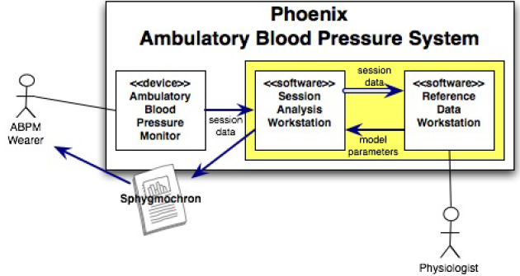
3 Architectural components implies 3 software projects/components
Embedded Software
Analysis Software (Sphygmochron)
Reference Data Workstation and Database

Slide 3
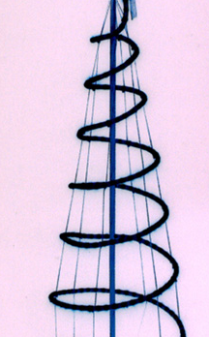
Software Development
Embedded Analysis Reference
I II
Vision √ √ √ √
Requirements √ √ √ √
Definition √
Design √ √
Code/Test √
Documentation
Post-release Support
Languages C VB Java Fortran
DB DB, C/C++
Java
√ Indicates some activity has taken place or is in progress

Slide 4
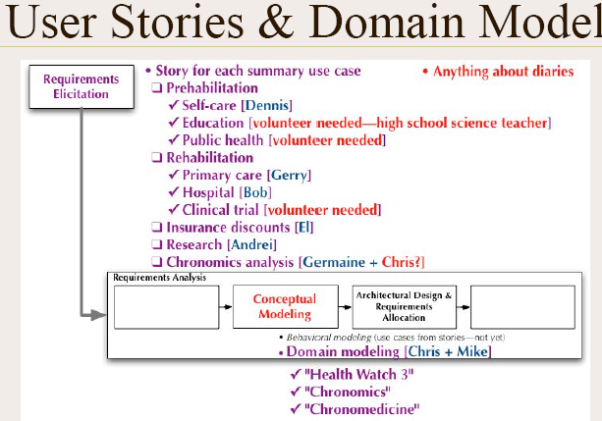

Slide 5
Embedded Software Project
Example Project Deliverables
  Selection of the development environment and microprocessor platform.
  Design of hardware prototype.
  Design of interface to sensor: RF link.
  Layout and fabrication of a printed circuit board containing the designs
  Bill of material
  Evaluation of the completed prototypes.
  Public invention disclosure and release.
  A written report.

Slide 6
Analysis Software I
Analysis software currently is VB macro in Excel
New code is expected to be developed via Test Driven Development
  COMUnit framework was adapted
  Example tests developed
Runs today as spreadsheet and web CGI
Produces Sphygmochron reports and charts

Slide 7
Analysis Software II
Expected to replace VB/spreadsheet
Expected to extend analysis algorithms
Expected to be Java
Prototype work defined, not started
    will include frameworks for:
        Numerical analysis
        2D graphics
        Persistence
        Error handling
        Report generation
        Data interchange — import of collected data and export of analyses

Slide 9
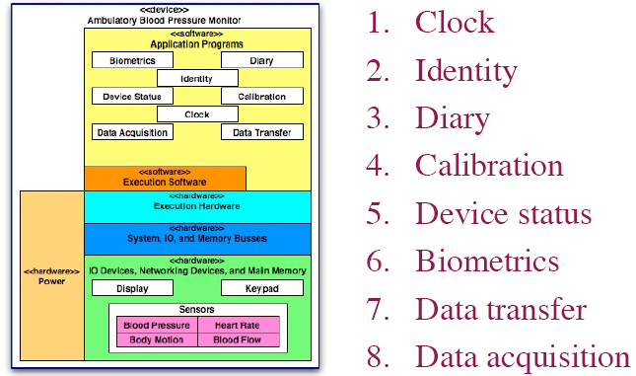

Slide 11
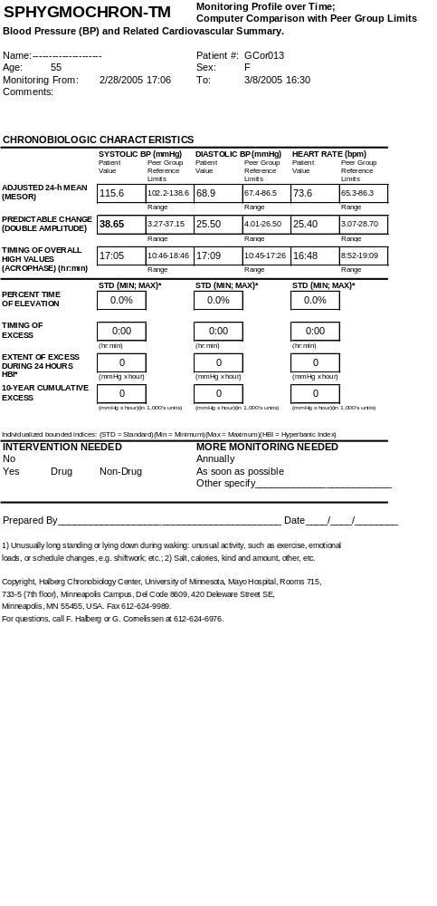

Slide 13
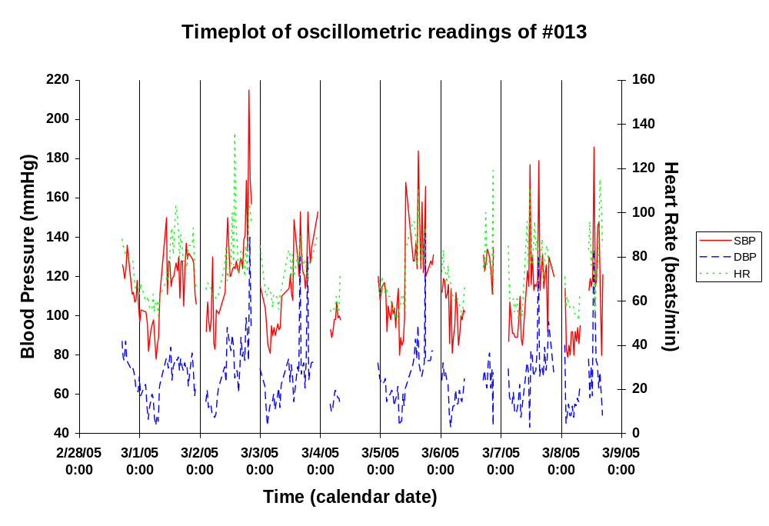

Slide 14
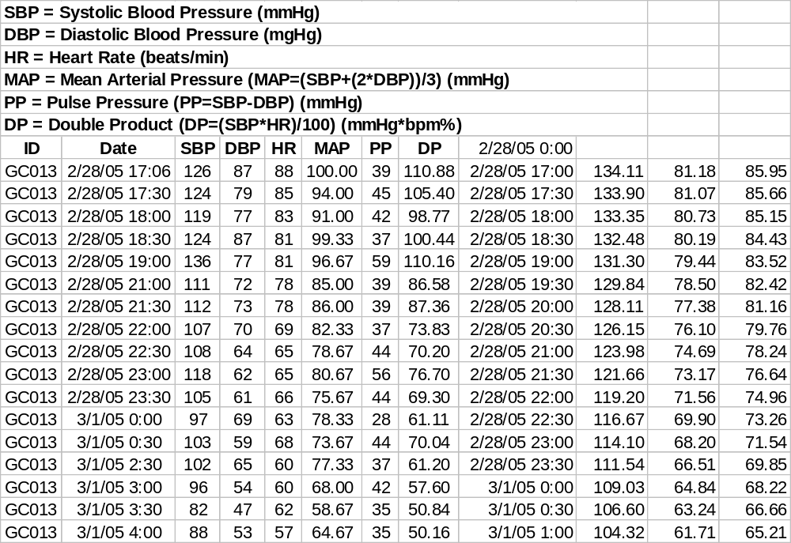

Slide 15
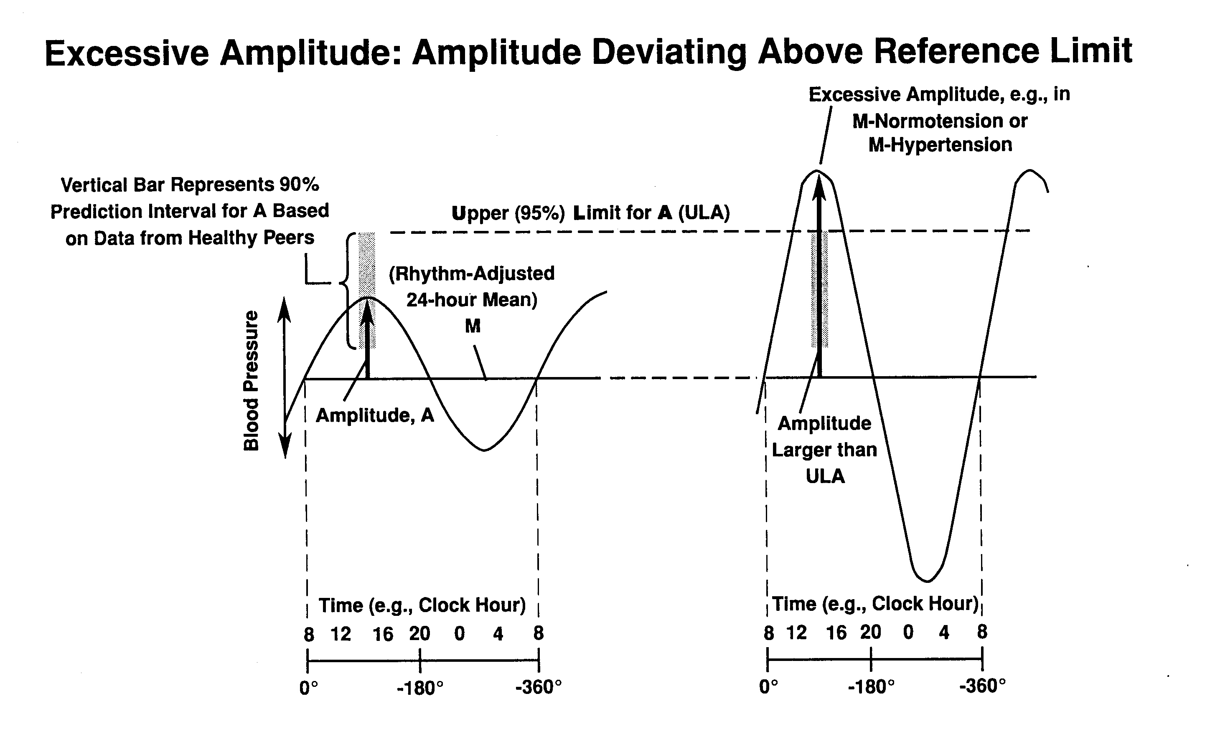

Slide 16
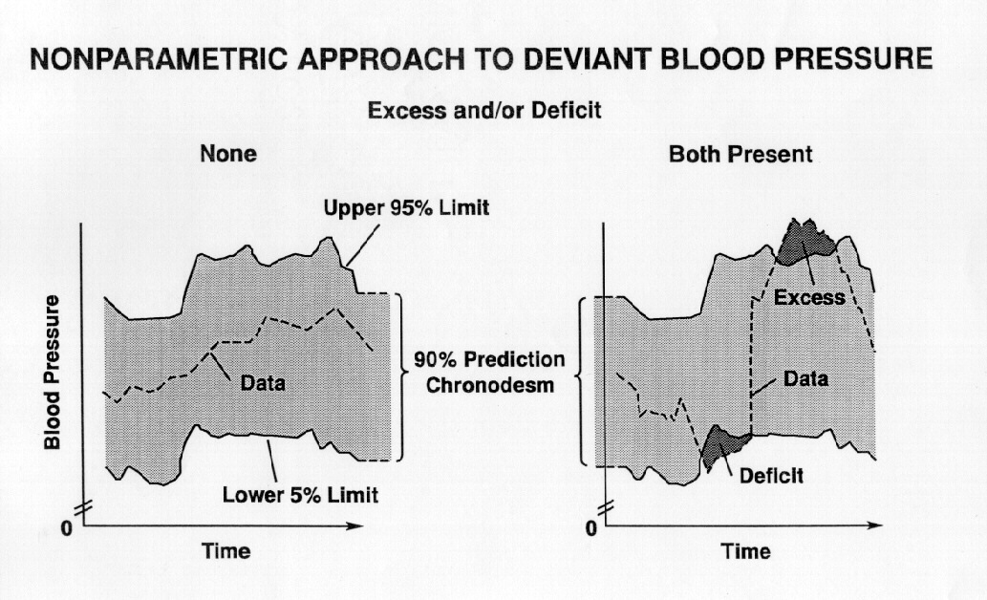

Slide 17
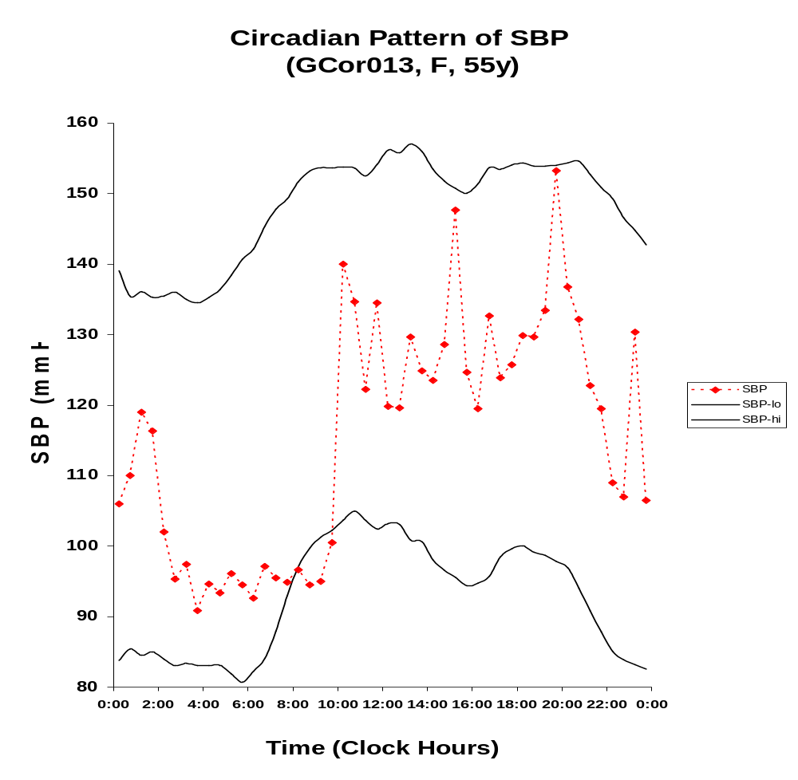

Slide 18
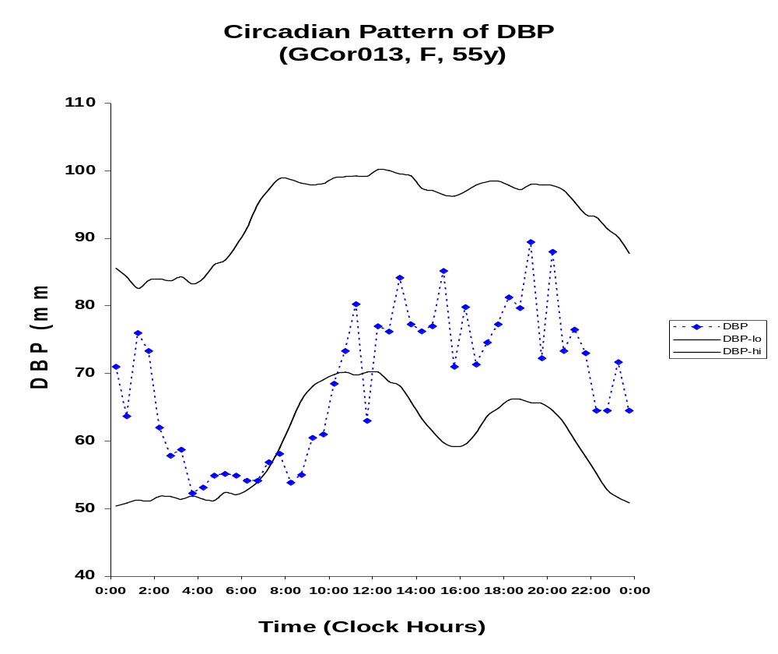

Slide 19
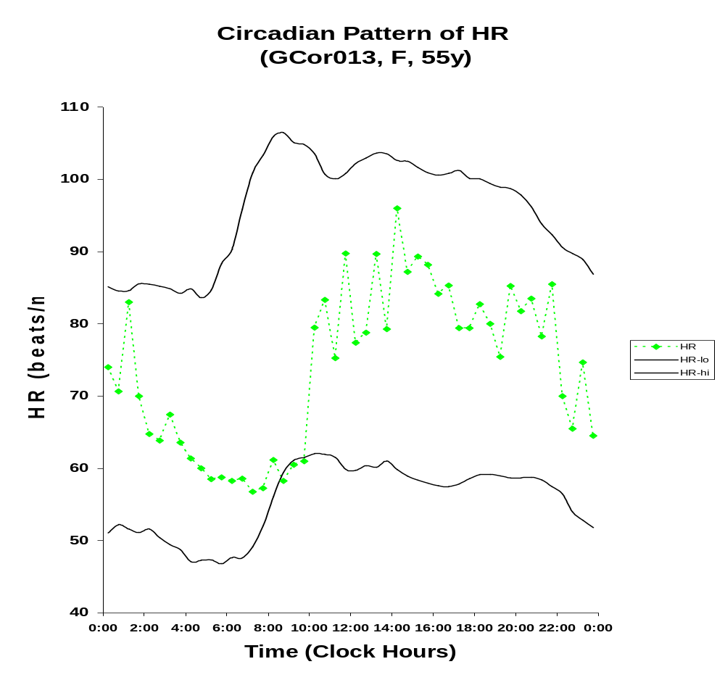

Slide 21
Definition: Test Driven Development
A software development process
  Not a testing technique, per se, but depends heavily on testing as a tool
Write tests first – the tests determine what code is to be written
Testing is done in a fine-grained fashion

Slide 22
Cost of development
Cost
Time
Traditional
TDD
Notes:
Turnover in people
Increase in complexity due to interactions between components of the system

Slide 23
Technique
Write a single failing test
Run the failing test
  “Proves” that the test is correct
Write minimal code that fixes the test
Run the test again
  “Proves” that the code is correct
Refactor towards a better design
Run the test again
  “Proves” that the better code is still correct

Slide 24
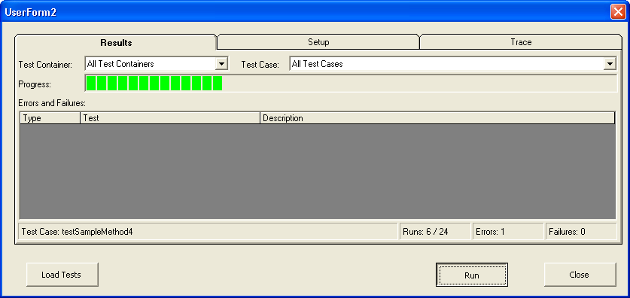
Elements of the test execution
User Interface

Slide 25
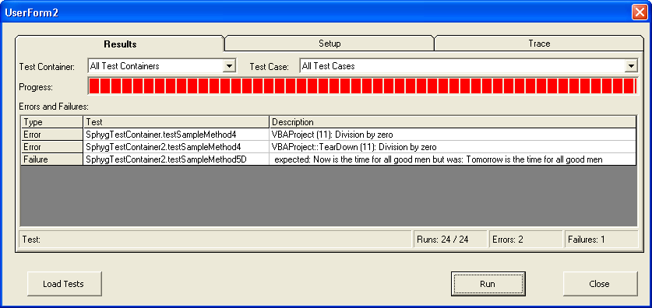
Elements of the test execution
User Interface

Slide 26

The function to be tested
Demo testing part of a standard deviation function in the original spreadsheet code
The calculation is done in two steps, according to a standard deviation formula often used in programs that keep “running sums” as they traverse over data:
  Add up the samples and the sum of samples
  “Finish” the calculation according to this formula:

Slide 27
The first Test function
Public Sub testFinishStdDevWith3DataPoints(oTestResult As TestResult)
Dim result As Double
' the data points are 7,8,9
result = FinishStdDev(3, 7 + 8 + 9, 49 + 64 + 81)
oTestResult.AssertEqualsDouble 1, result, 0.1
End Sub

Slide 28
Write stub function
    Doesn’t actually compute the return value yet
Function FinishStdDev(N, sumOfSamples, sumOfSquares)
FinishStdDev = 0
End Function

Slide 29
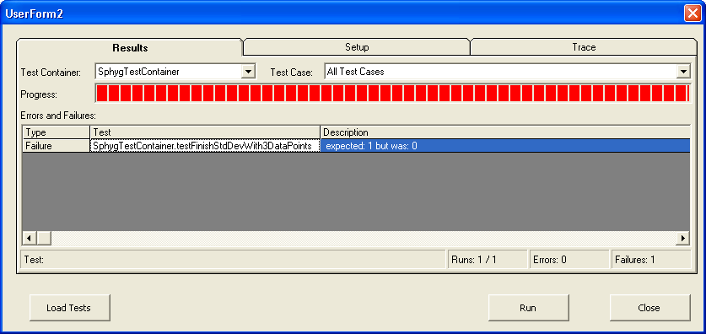
Run tests, test fails

Slide 30
Implement function to be tested
    Here’s the function from the original Sphygmochron spreadsheet. I’m leaving a few lines commented out because we don’t need them yet. (I’m “implementing” the smallest possible bit of the code to make the test pass.)
Function FinishStdDev(N, sumOfSamples, sumOfSquares)
temp = ((N * sumOfSquares) - (sumOfSamples ^ 2)) / (N * (N - 1))
'If temp < 0 Then
' temp = temp * -1
'End If
FinishStdDev = Sqr(temp)
End Function

Slide 31
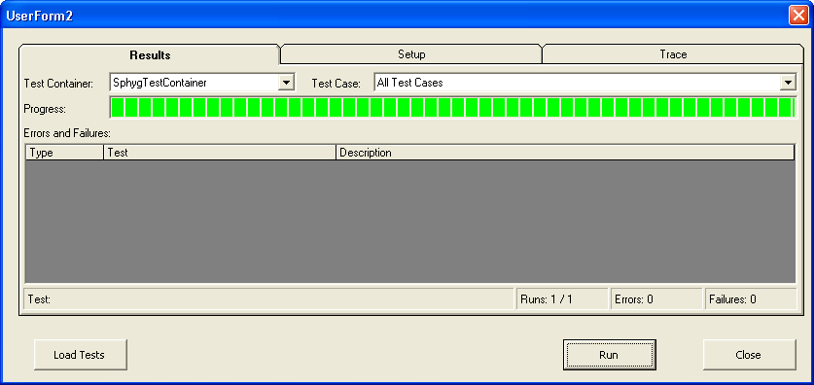
Run tests, test now passes

Slide 32
Wrap-up
I took 4 lines of code from the original Sphygmochron code and made it a testable function
I found a divide-by-zero error, an apparently unnecessary and poorly-coded “absolute value” function, and a missed opportunity for detecting bad input data, all in what we thought were 4 correct lines of code
Refactoring tests gave me a very easy (1-line) mechanism to use to write future tests for this function
If any future programmer changes the function, my tests prevent from breaking functionality that I know is important today
TDD enabled me to do this by encouraging thinking about valuable test cases before implementing the parts of the function

